Slide 1
Effectively Engaging Stakeholders – Guidelines for Success
K.G.Guru Prasad
Director, ERS-SDES-Online
HCL Technologies
Notes:
Module 0

Slide 2
Seminar Milestones
Introductions
Stakeholder Identification
Stakeholder Engagement
Continuous involvement
Guidelines for Success
Parting Thoughts
© Ginger Levin, 2016

Slide 3

About Me

Slide 4

Participants
Tell us something about YOU! A Two Minute Elevator Speech!
  Name
  Background
  Expectations for this seminar
  Something funny!

Slide 5
Our Objectives
At the end of the session, you should be able to:
  Use different methods to identify stakeholders
  Determine the best approaches to engage stakeholders in your work and to build trust
  Recognize how to work with your stakeholders to proactively accept changes in your work
  Focus on active listening when stakeholders have concerns, issues, or suggestions
  Work with stakeholders to promote organizational value
  Network, Have Fun, AND earn PDUs!
  Win a Raffle Item???

Slide 6
Seminar Milestones
Introductions
Stakeholder Identification
Stakeholder Engagement
Continuous involvement
Guidelines for Success
Parting Thoughts

Slide 7

Key Definitions
Portfolio
Program
Project
Adapted from PMI® PMBOK® Guide Fifth Edition and Portfolio Standard Third Edition

Slide 8
What is a Stakeholder? (1 of 2)
“A stakeholder in an organization is any group or individual who can affect or is affected by the achievement of the organization’s objectives. (Freedman, 1984, p. 4)
R.E. Freedman, Strategic Management: A Stakeholder Approach”, 1984

Slide 9
What is a Stakeholder? (2 of 3)
“An individual, group, or organization who may affect, be affected by, or perceive itself to be affected by a decision, activity, or outcome of a project.” (PMI, 2013, p. 563)
PMI, PMBOK® Guide - Fifth Edition, 2013

Slide 10
Stakeholder Definitions – Program and Portfolio Management (3 of 3)
“An individual or group of individuals who has an interest in the program and can influence or be influenced by its process or outcomes” (p. 45)
      PMI, The Standard for Program Management – Third Edition
“Individuals or groups whose interests may be positively or negatively influenced by portfolio components or portfolio management processes” (p. 26)
      PMI, The Standard for Portfolio Management – Third Edition

Slide 11

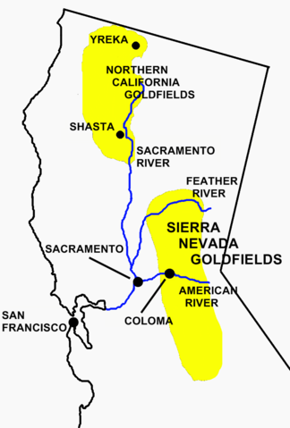
How Did the Term Stakeholder Originate?
From gold mining!
  In the great ‘gold rush’, one needed to have a formally assigned claim, a mining ground, before they could start digging – they then put a ‘stake’ in the ground to indicate their claim
        Source Oliver Lehmann, “Situational Project Management”, forthcoming

Slide 12
Stakeholders and the Project Field
“You cannot get large projects carried out without persuading large numbers of extremely difficult sorts of people to understand the importance of what is being done and to work together”
        Baker,1962, p. 328, study of large capital projects in the UK
Defining stakeholders’ expectations based on their perception of the project’s objectives and determining the extent to which they are (or are not) fulfilled can predict the success of a project
        de Abreu and Conrath, 1993
“The continuing developments of relationships with stakeholders for the purpose of achieving a successful project outcome”
        McElroy and Mills, 2003, p. 103

Slide 13
Stakeholders and PMI, 1996
Stakeholder definition: “Individuals and organizations who are involved in or may be affected by project activities” (p. 170)
Stakeholder analysis:
  A tool and technique for Organizational Planning – to ensure stakeholder needs are analyzed and can be met (p. 96)
  Also in Communications Planning – analyzed to determine information needs and how to meet them –”avoid wasting resources on unnecessary information or inappropriate technology” (p. 106)
Risk quantification – “an opportunity for one stakeholder (reduced cost) may be threats to another (reduced profits)” (p.115)
PMI, A Guide to the Project Management Body of Knowledge, 1996

Slide 14
Stakeholders and PMI - Today
Stakeholder Management – A Knowledge Area in PMBOK 5
Stakeholders – A Domain – in the Program Management Standard Third Edition
Stakeholder Analysis – A tool and technique in Manage Strategic Change, in Develop the Portfolio Communications Management Plan – in the Portfolio Management Standard Third Edition
They are always present in our work!

Slide 15
The List of Stakeholders Is Huge
Project Management
  Sponsor, team, PMO, program managers, portfolio managers, operations managers, functional managers, customers/users, procurement, finance, government regulators, SMEs, consultants, and OTHERS (PMBOK® 5)
Program Management
  The above PLUS – governance boards, performing organization, program team members, potential customers, competitors, affected individuals, consumer groups, environmental groups, or other interests (PMI, Program Management Third Edition)

Slide 16
Portfolio Management Stakeholders
Portfolio Stakeholders | Interest, Influence, and information Needs | Why
External | Business partners Competitors Government Industry Legal Customers Investors Shareholders Public relations | Related to the overall portfolio and changes being made
Internal | Business operational stakeholders | Ensure alignment of portfolio components Minimize negative impact Maximize positive benefits
Portfolio Management Standard, p. 110

Slide 17

In Addition, Remember the ‘Hidden” Organization Chart
The people who are the true drivers (or roadblocks of progress) . . the less obvious . . with broad experience . . . key influence. . . and can help ‘connect the dots’ – Amy Baugh, Stakeholder Engagement, p. 33

Slide 18
Group Discussion
Research from the 1980s to today shows 90% of the project manager’s time is spent communicating.
  Do you feel more overwhelmed by stakeholders?
  Are there too many who have an interest in some aspect of your work?
  Are you constantly rushing from meeting to meeting?
  Do you then often overlook a key stakeholder or stakeholder group?

Slide 19
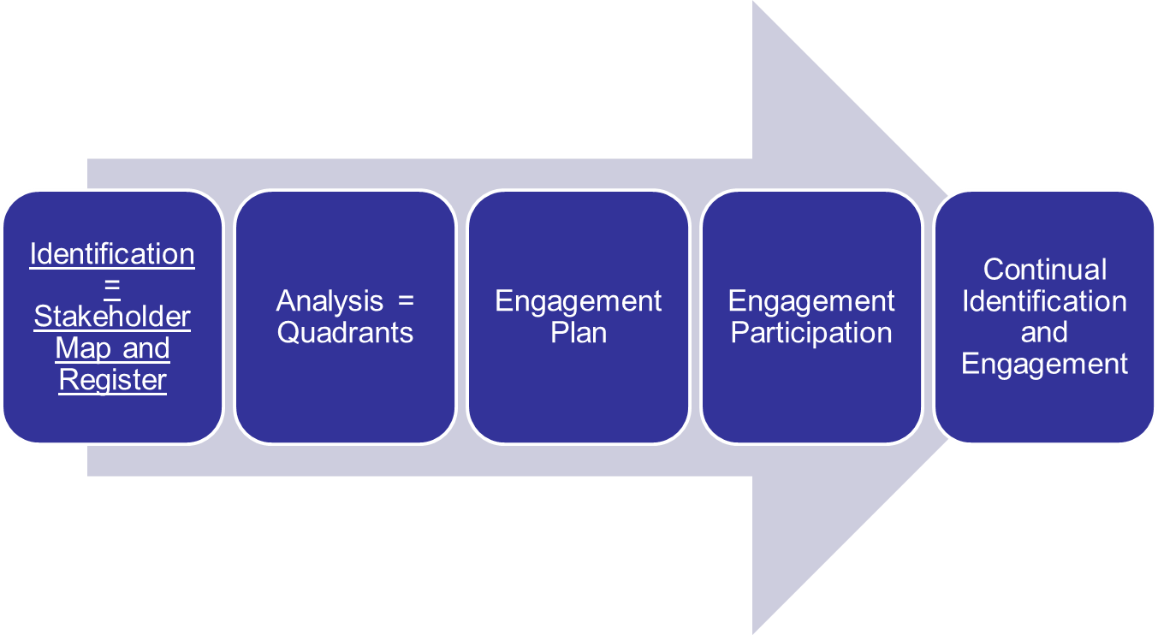
Steps to Take #1

Slide 20
Identification Approaches
Brainstorming
  Entire group – free form
  Nominal group technique
Focus groups
Reviewing documents
  Lessons learned
  Charters, WBS
  Standards/Regulations
  Procurements
Interviews
Questionnaires and surveys
Experts
Delphi approach
Profile analysis meetings
  Roles, interests, stakeholder position
OTHERS??

Slide 21
Interview Suggestions / Questions
Use open-ended questions
Who have you worked with in past, similar initiatives?
  Who did you turn to if you had questions?
  Who were proponents/opponents?
  How were these initiatives successful?
How is this initiative related to other portfolios, programs, or projects?
Can you recommend others for me to talk with about this initiative?
  Can you think of other people who might have concerns or interests?
Adapted from Baugh, pp. 37-40

Slide 22
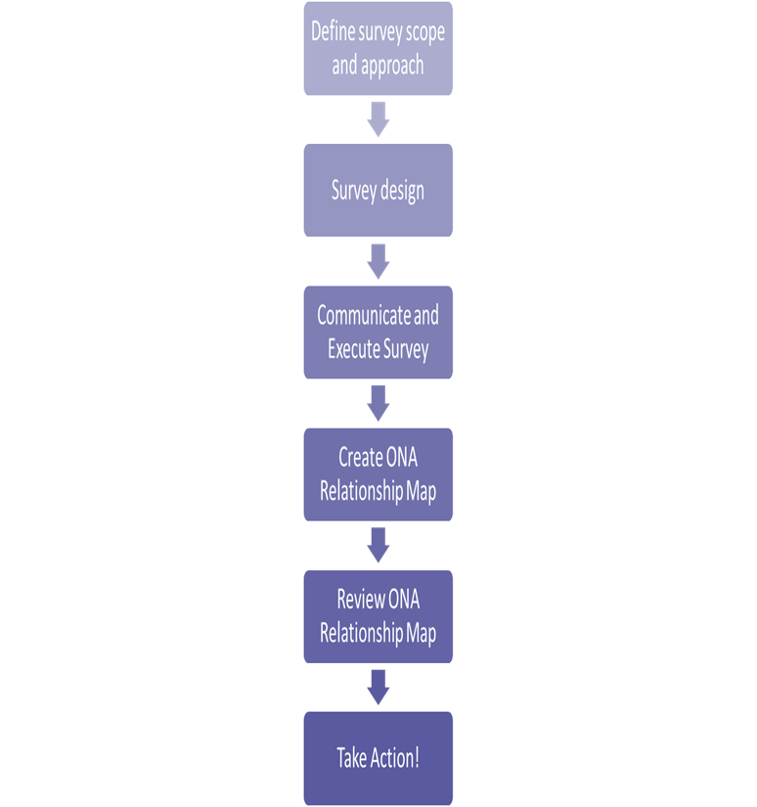
An Organizational Network Analysis
Determine the goal of the ONA for your portfolio, program, or project
Prepare the survey
Send it out – with communications
Analyze responses – prepare the ONA map
Review it for ‘hubs’, opportunities, bottlenecks, peripheral stakeholders
Review results for your stakeholder register and engagement strategy
Adapted from Baugh, pp. 43-45

Slide 23
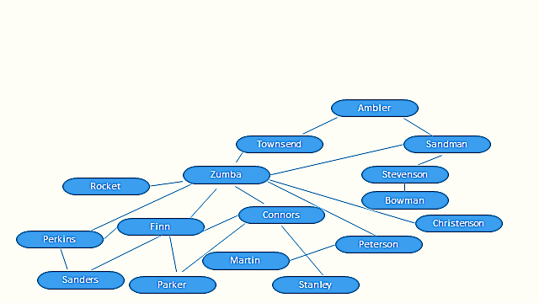
Organizational Network Structure Map
Adapted from Baugh, p. 43

Slide 24
Stakeholder Circle Approach – Step 1- Identification
Purpose
  Know who stakeholders are at a particular time
  Gather information about people and groups to target communications
Determine spheres of influence
  Upward: senior managers for commitment
  Downward: members of the team
  Outward: outside of the project
  Sideward: peers of the project managers, CoPs
Adapted from Lynda Bourne, Making Projects Work, p. 43

Slide 25
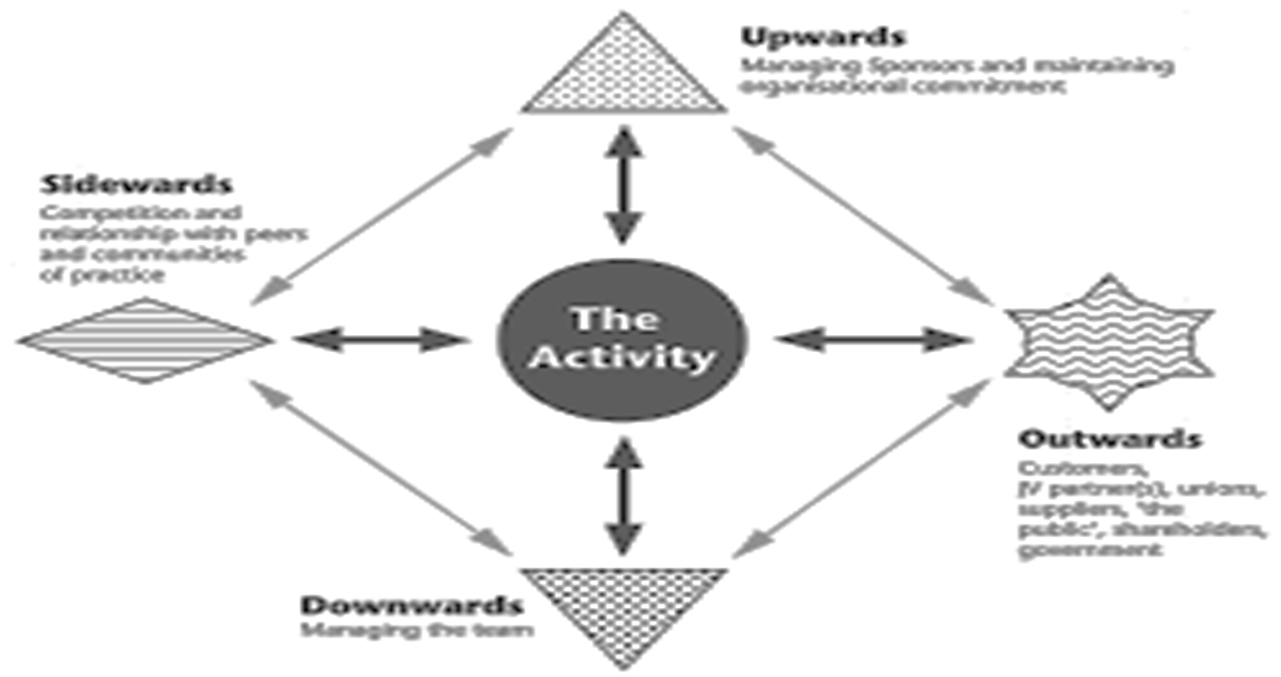
Example – Stakeholder Circle - Identification
Adapted from Lynda Bourne, Making Projects Work, p. 43

Slide 26
The Next Step:
The Stakeholder Register
Name | Position | Contact Information | Areas of Influence | Portfolio, Program, or Project Opinion | Portfolio, Program, or Project Impact
Management Strategy | Information Requirements | Responsible Team Members | Issues Identified | Resolution and Date | Notes
Adapted from Levin and Green, 2013

Slide 27
Group Discussion
In your work, how much time is spent on stakeholder identification?
What approaches to you feel are the best ones to use?
Who is involved as you identify stakeholders?
Do you feel a register helps?

Slide 28
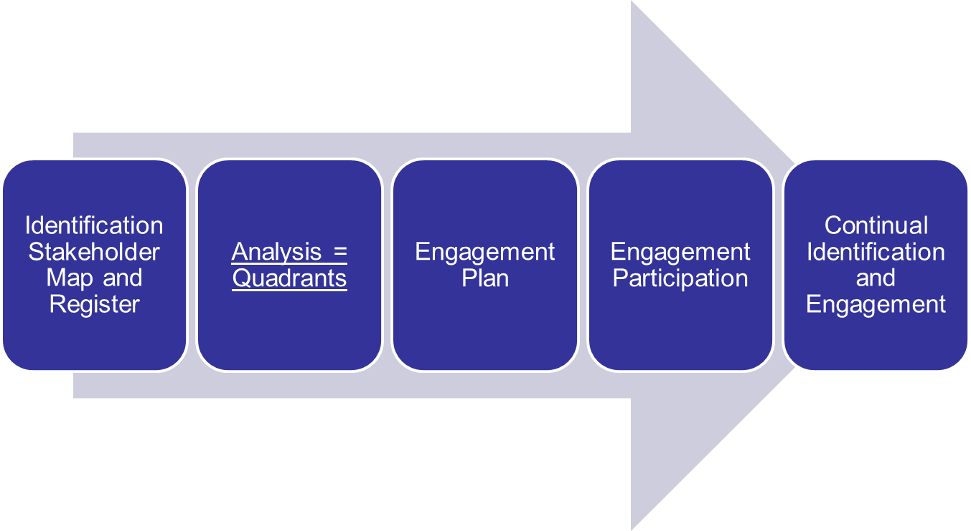
Steps to Take #2

Slide 29
Stakeholder Analysis - Steps
Identify all the stakeholders and their key information – stakeholder register
Classify the stakeholders into groups by analyzing their impact and support
Assess how the stakeholders might respond in various circumstances
PMBOK 5, p. 396

Slide 30
Questions to Assess Influence
Who are the members of the governing body?
Which stakeholders are thought leaders, influences, or early adopters?
What is the stakeholder’s level of authority?
What is their political influence?
Is their stakeholder role recognized by the organization?
What are their interrelationships?
Which stakeholders can influence others?
Portfolio Management Standard, p. 110

Slide 31
Other Suggestions
Power
  The power the stakeholder or group has or may have to change or stop the initiative
  Recognize the extent of the power
Proximity
  Involvement the stakeholder has with the team
Urgency
  Time sensitivity
  Criticality
  The value the stakeholder has on the outcome of the initiative
  The action the stakeholder may take
Adapted from Bourne, pp. 44-45

Slide 32
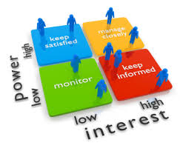
Key Classification Models – Power/Interest Grid

Slide 33
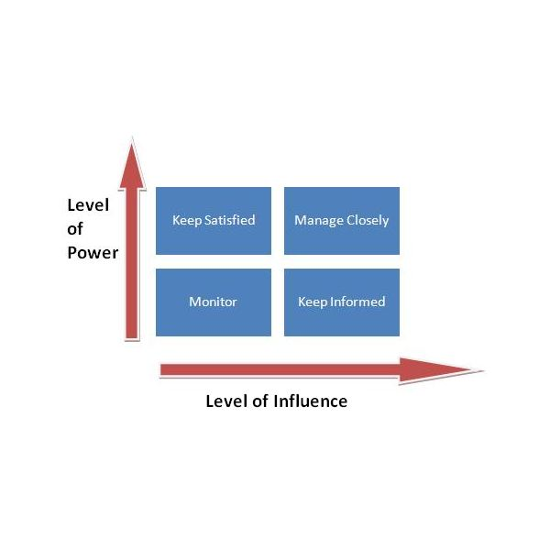
Power/Influence Grid

Slide 34
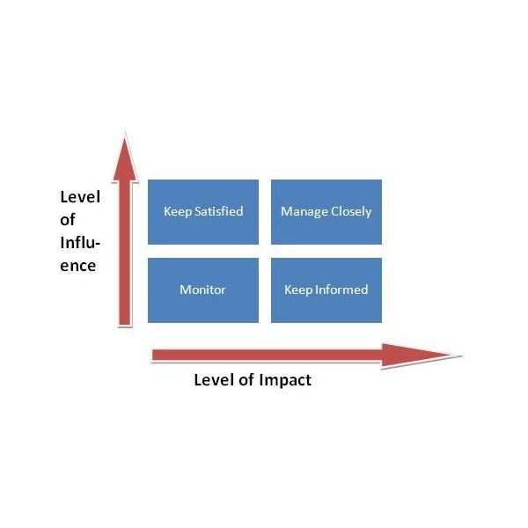
Influence / Impact Grid

Slide 35
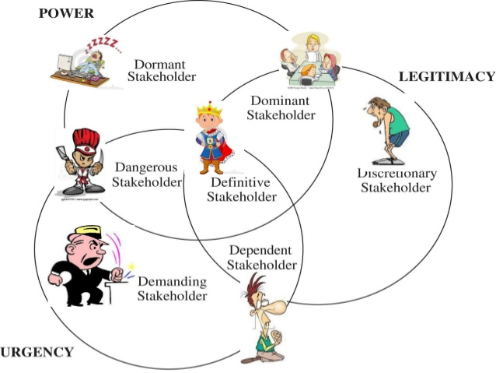
Salience Model
www.slideshare.net

Slide 36
Group Discussion
Assume you are classifying stakeholders at work, which approach to do feel is the best one?
How much time does it take to do it?
How often do you use it?

Slide 37
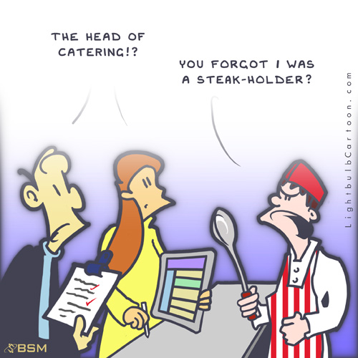

Slide 38
Seminar Milestones
Introductions
Stakeholder Identification
Stakeholder Engagement
Continuous involvement
Guidelines for Success
Parting Thoughts

Slide 39
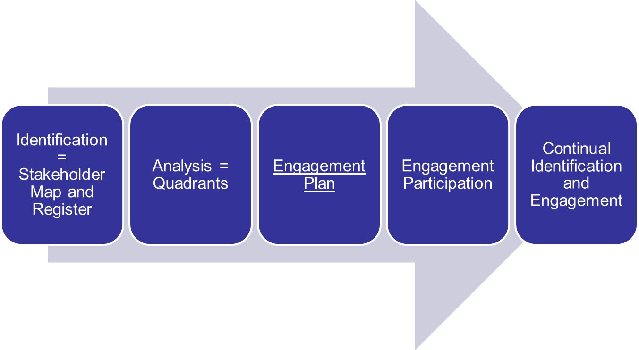
Steps to Take # 3

Slide 40
Definition
Stakeholder Engagement Plan:
  A detailed strategy for effective stakeholder engagement on the program
  Includes stakeholder engagement guidelines
  Provides insight as to how component stakeholders are engaged
  Defines metrics to measure performance of stakeholder engagement activities
The Standard for Program Management, p. 160

Slide 41
Stakeholder Engagement Planning
Purpose: Satisfy how all program stakeholders will be engaged during the program
Analyze the stakeholder engagement plan and the:
  Organization’s strategic plan
  Program charter
  Program business case
  Establish a balance between activities needed to mitigate negative stakeholders and encouraging those who view the program positively
The Standard for Program Management, p. 49

Slide 42
Classify the Stakeholder Engagement Levels
Unaware = Unaware of the portfolio, program, or project and potential impacts
Resistant = Aware but resistant to change
Neutral = Aware but not supportive or resistant
Supportive = Aware and supports change
Leading – Actively engaged in supporting the change
PMBOK 5, p. 401

Slide 43
Consider a Stakeholder Engagement Assessment Matrix
Stakeholders | Unaware | Resistant | Neutral | Supportive | Leading
Ginger | C |  | D
Jeff |  |  |  |  | C, D
Teri |  | C |  | D
Liz |  | C |  |  | D
C = Current Engagement Level D = Desired Level
PMBOK 5, p. 402

Slide 44
Stakeholder Engagement Plan Contents
Detailed strategy for stakeholder engagement
Stakeholder engagement guidelines
Insight as to how stakeholders in the components are engaged
Guidelines for component-level stakeholder engagement
Metrics to measure performance of stakeholder engagement activities
  Participation in meetings
  Participation in communications
  Effectiveness of engagement activities in meeting goals
Use it in communication planning and ongoing alignment
The Standard for Program Management, p. 49

Slide 45
One from PMBOK 5, p. 403
Data from the stakeholder register
Stakeholder desired and current engagement levels
Scope and impact of the change to stakeholders
Stakeholder inter-relationships/overlaps
Stakeholder communications requirements
Information to communicate, time needed, and channels to use for expected impact on stakeholder engagement
Method to update/refine the plan

Slide 46

Have Sign-Offs on the Plan
Portfolio, program, project manager
Sponsor
PMO Director
Governance Board Chair and Members
Key Stakeholders !!!

Slide 47
Group Discussion
Do you prepare stakeholder engagement plans?
  If yes – what are the typical contents?
  Are they part of the communications management plan?
  Are they in the project management plan?
  Are they needed???

Slide 48
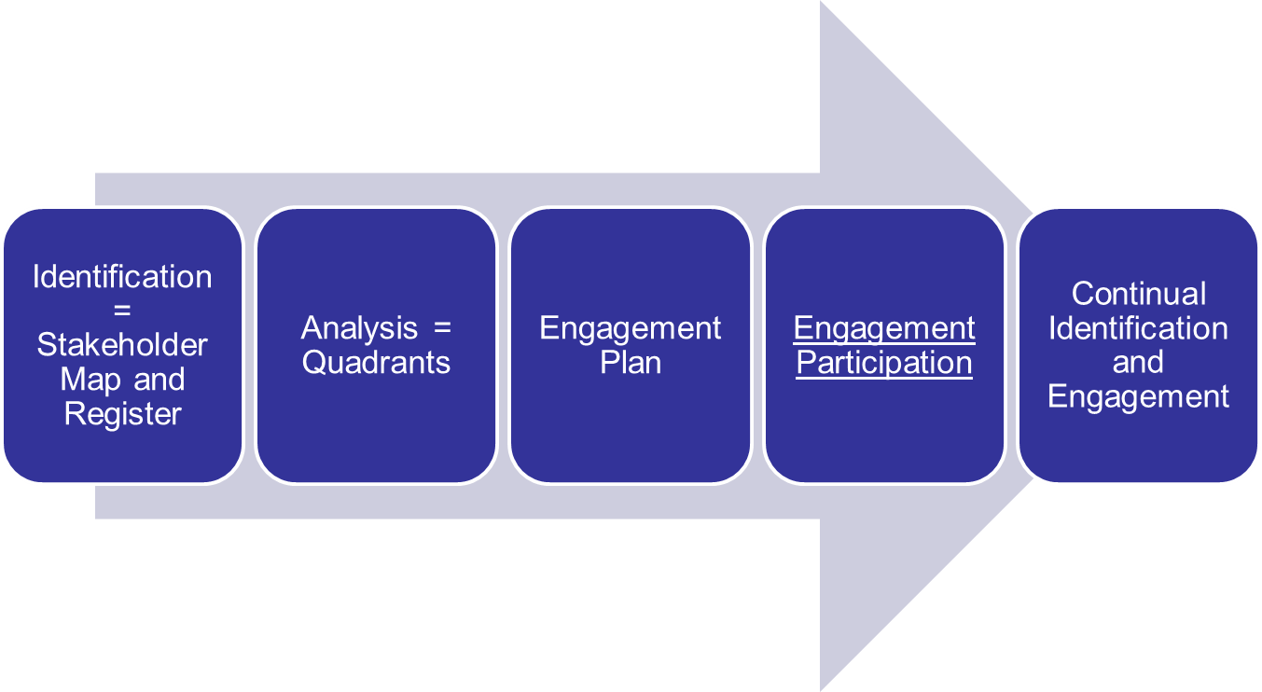
Steps to Take # 4

Slide 49
Building Stakeholder Relationships
Consider the following:
  Who is the stakeholder?
  What help do you and your team need from the stakeholder?
  What does the stakeholder need from the team?
  Are there common objectives between the team and the stakeholder?
  Are there potential barriers between the team and the stakeholder? Can they be overcome?
  Which team member will work with each stakeholder?
  What steps can you take for a positive relationship?
Adapted from Parker, 1994

Slide 50

Develop Stakeholder Profiles
Assess the actual attitude of selected stakeholders
Describe the realistic target attitude of the stakeholders responsible for success
Determine the level of support and receptiveness that would best meet the needs of both the portfolio, program, or project manager and the stakeholder
  Is there an important stakeholder who is actively opposed and will not receive messages? If yes, what do you do?

Slide 51
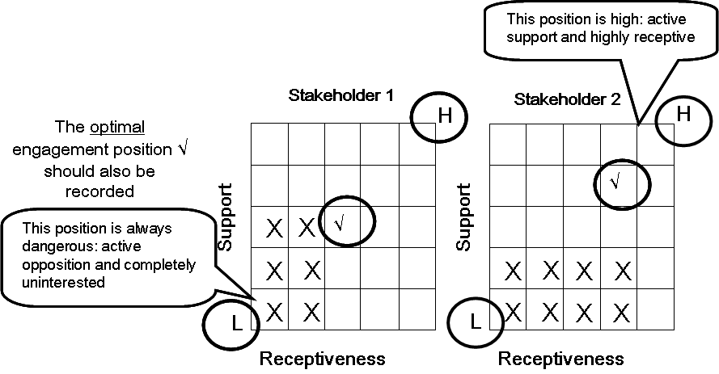
Examples of Stakeholder Engagement Profiles
Adapted from Bourne, 2015

Slide 52
Value of Effective Stakeholder Engagement (1 of 3)
It will be different for each stakeholder group
  Consider if the value is tangible or intangible
Remember stakeholder engagement is FREE
  Consider the cost of not engaging all stakeholders – it could lead to :
    Loss of assets, loss of shareholder value, loss of reputation, reduced staff morale, people leaving the organization
Adapted from Bourne, 2015

Slide 53
Value (2 of 3)
Value to the Organization
  The importance of the program or project for organizational success and business value
  Assess costs of delays and budget overruns
Value to the Stakeholders
  Are the stakeholders getting the information they need, are they consulted, are their concerns addressed?
Adapted from Bourne, 2015

Slide 54
Value (3 of 3)
Value of the Program or Project
  Determine who is important and how best to deliver information to stakeholders to engage them
  Provide feedback on the work that is being dome – communication from the stakeholder
  Obtain early warning about events that may impede success - communication from the stakeholders
  Target communications
Value to the Team
  The team can operate more effectively
  They gain a sense of achievement with communications and engaging with stakeholders
  They learn more about working together and working with stakeholders – knowing the politics and the environment
Adapted from Bourne, 2015

Slide 55
Considerations
Capture questions and answers to them raised by stakeholders and publish them
Set up a log of communication to and from stakeholders
Set up an issue log to track issues to resolution
  Use impact analysis to determine urgency and probability of issues – goal is to avoid issues becoming risks
Review metrics for stakeholder engagement
  Positive contributions to the program’s objectives and benefits
  Participation in the program
    Identify risks from lack of participation
    Analyze participation trends
    Perform root-cause analysis
  Communications with the team
The Standard for Program Management, pp. 49-50

Slide 56
Stakeholder Communications Strategy Matrix
Setting Stakeholder Communications Strategy
 |  | Level of Interest
 |  | Low | High
Level of Influence | Low | Apply Minimal Effort | Keep Informed
 | High | Active Communications | Active Communications and Engagement
Portfolio Management Standard, p. 111

Slide 57
Set Expectations with Stakeholders
Have additional meetings with the powerful, influential stakeholders after identifying them
Strive to avoid making assumptions!
Determine how people want to receive information
Building strong relationships involves building trust
  It takes time!
Adapted from Baugh, p. 55

Slide 58
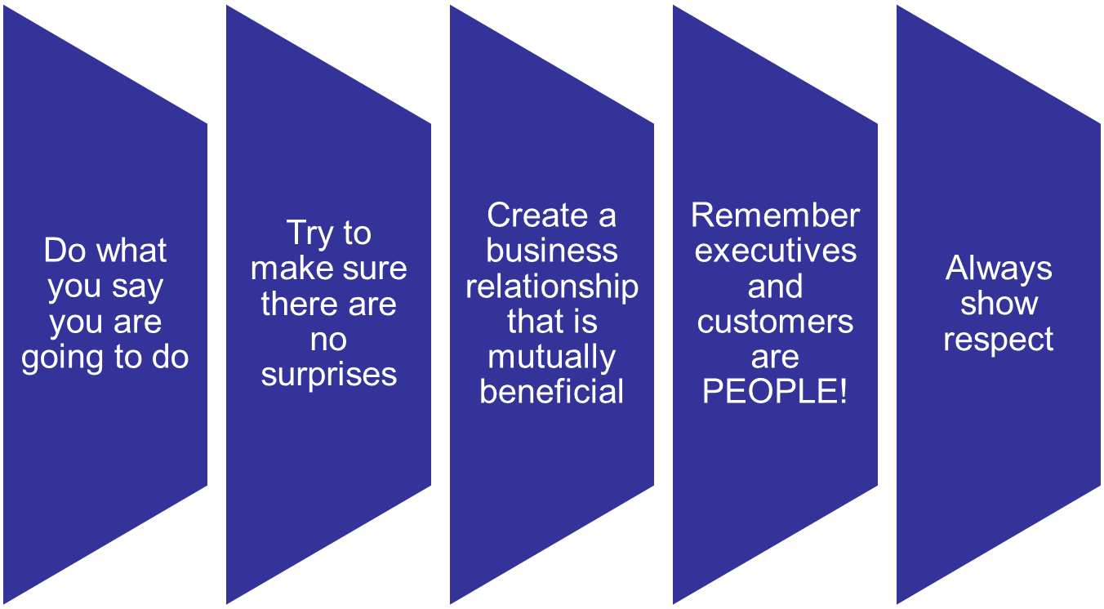
Five Key Principles for Building Relationships
Adapted from Baugh, p. 56

Slide 59
Ask Some Leading Questions!
I am struggling to recognize how my project contributes to our organization’s vision when I talk with people – can you help me?
I am new here and managing this major program. How do you suggest I build my network? Whom do I need to contact?
I just reviewed the benefits the previous program manager listed – I really do not see the value of some of them. Can you help me figure out which ones are the most important?
Adapted from Baugh, 2015, p. 10

Slide 60
Seminar Milestones
Introductions
Stakeholder Identification
Stakeholder Engagement
Continuous involvement
Guidelines for Success
Parting Thoughts

Slide 61
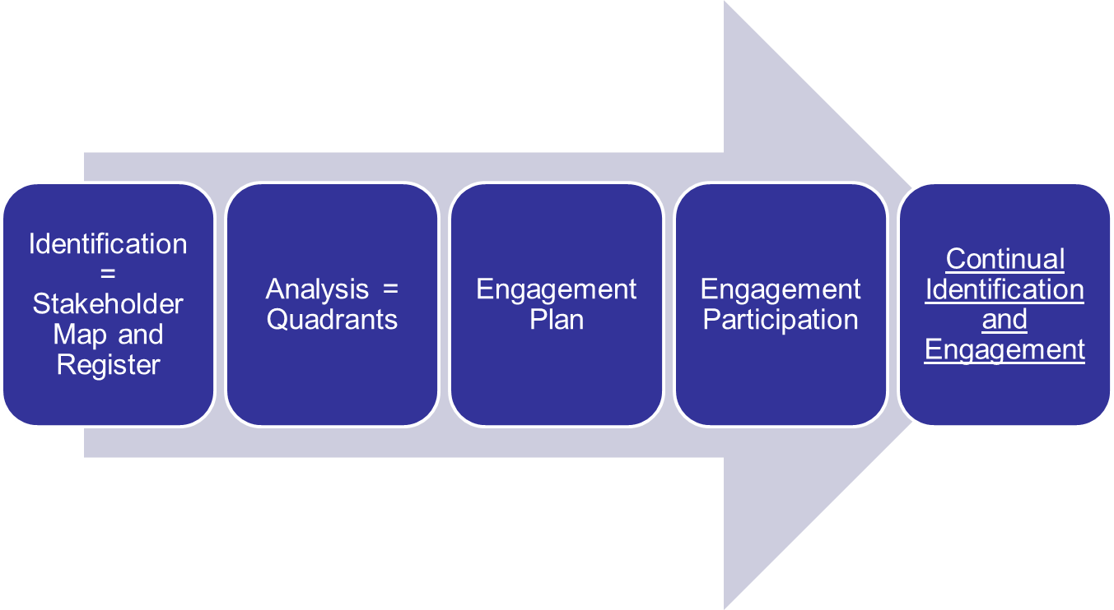
Steps to Take # 5

Slide 62
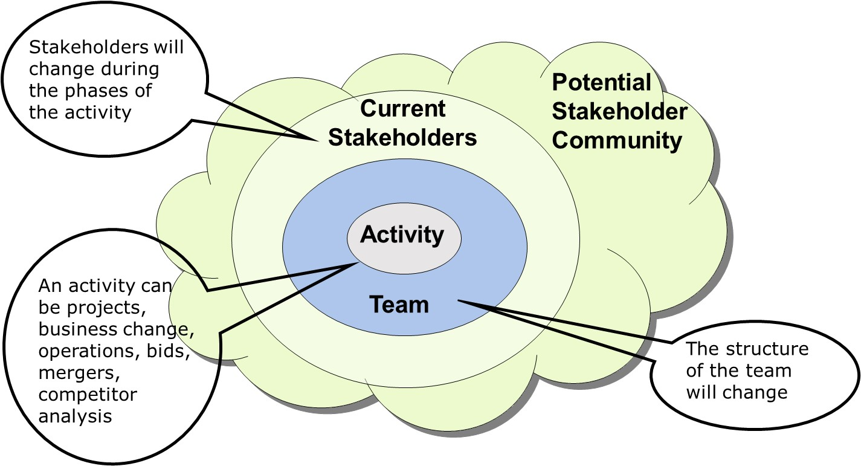
Stakeholder Engagement is Ongoing
Adapted from Bourne, 2015

Slide 63
Remember
Continually engage with stakeholders
  Communication requirements may change
  Ensure communications needs are met
  Ensure needs align with the stakeholder engagement plan
  Obtain feedback on the plan
Use interviews, questionnaires/surveys, meetings, lesson learned sessions, brainstorming
Portfolio Management Standard, p. 112

Slide 64
Close the Expectations Gap
Expected Value
Expectations Gap
Stakeholder Engagement
$
Delivered Value
TIME
Adapted from Baugh, 2015, p. 4

Slide 65
Continue to Provide Input to Stakeholders But . . .
Ask questions
Push gently
But be ready to alter your approach with key stakeholders and stakeholder groups
Watch for these types of stakeholder responses:
  Avoiding direct contact
  Shifting uncomfortably
  Being defensive
  Raising one’s tone of voice
  Giving a vague response
Adapted from Baugh, 2015, p. 10

Slide 66
Effective Stakeholder Engagement
Build relationships outside of your normal network – and keep them up!
  Determine those who are the most politically connected
Recognize some are always going to want to raise an objection
  Determine who they are and how to best respond
  Address your concerns directly
Enhance your negotiating skills!
Clarify why something is important to a stakeholder
  Actively listen
  Have some options ready
  Strive to avoid saying NO!
Adapted from Baugh, 2015, Chapter 10

Slide 67
Engagement is Continuous
Especially as a portfolio manager but also for program and project managers
  Benefit sustainment
Build lasting relationships
Thank people for their help
Re-examine what worked well and what could have been done differently
Remember – Continuous Improvement Not Business As Usual is Required for Success!

Slide 68
Group Discussion
How often do you engage with stakeholders?
Do you have members of your team responsible for certain stakeholders?
What approaches do you use?

Slide 69
Seminar Milestones
Introductions
Stakeholder Identification
Stakeholder Engagement
Continuous involvement
Guidelines for Success
Parting Thoughts

Slide 70
Why Is Stakeholder Engagement Important?
Only 32% of Executives
State their organizations “successfully execute initiatives/projects to deliver strategic results”
“Only 62% of strategic initiatives meet original goals and business intent”
And the
Result is:
Source: PMI® Pulse of the Profession™, 2016 pp. 23, 26

Slide 71






Why Is This Hard??
Did we really want to reach out to negative people?
No one is responsible
The CEO has left – who cares if we did not talk with some key people?
I am the program manager – I lack the time to work with all of my stakeholders
The program is over – and I really do not care if some key stakeholders still had concerns – I got my bonus
Since we now follow Agile, do we need to engage our stakeholders?

Slide 72









Remember Often the Problem is a Lack of Information
Only a few people are in the know
People are taken by surprise
There is no advance
warning of the new program or project or the move to portfolio management
The decision has been made,
we then must accept it
Resist
Change!
Resist Change!
We lack information as to how to best work to engage stakeholders as before we worked in silos
Limited, if any, meetings are held to describe why we are pursuing the new initiative and its benefits

Slide 73
Guideline #1
Recognize who the stakeholders are that have the power, interest, or influence to stop or even cancel your work
  If these stakeholders are not engaged, you may not even know why it happened
Therefore, spend time identifying stakeholders and keep doing it!

Slide 74
Guideline #2
Use a model and classify stakeholders into groups
  Let the model serve as the basis for focusing communications and your own time
Use stakeholders to help shape strategy from the beginning
Remember: You need to keep the proponents as active supporters so focus as much or more attention on them as you do on the resistors

Slide 75
Guideline # 3
Work to assume trust from the beginning
  But have a contingency plan if the trust is broken
  One negative person on a team can de-motivate the rest of the team
Recognize what is working well with stakeholders and areas of improvement
  Discuss engagement at various meetings
  Sincerely solicit stakeholder feedback and ask if things have improved; if not – change!

Slide 76
Seminar Milestones
Introductions
Stakeholder Identification
Stakeholder Engagement
Continuous involvement
Guidelines for Success
Parting Thoughts

Slide 77
We all know the old adage, that project management is 90% communication. A large proportion of communication is working with stakeholders. If you cannot devote quality time to working with your stakeholders using well-conceived strategies, you will probably be placing your program or project at risk in some way or another.
Tips on Stakeholder Management
Written by Gareth Byatt, Gary Hamilton, and Jeff Hodgkinson, 2012

Slide 78
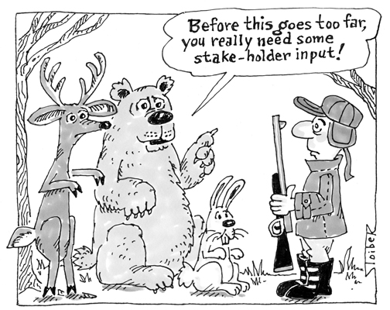

Slide 79




Thank You!

